Slide 2
Content
Goals
Constraints
Assumptions
Requirements Analysis
Scenarios
Use Cases
Class Diagram
Alloy Model

Slide 3
Goals
The driver can
Register/log into the system
Locate available cars within a distance around a position
Reserve a car for up to 1hour
Unlock a reserved car if he is close enough and pick it up
Enable the saving money option and give his destination
The system should
Start charging once the car ignites
Stop charging once the car is parked in a safe area
Apply discounts/charges according to the driver’s ride
Provide a power grid station to the driver selecting the saving money option
Inform the driver of the cost in real time
Provide the price of the ride at the end

Slide 4
Constraints
Ensure safety of driver details and transactions
The system is compliant with local laws about drivers’ details
The system can work with most of online mean of payment

Slide 5
Assumptions
The driver
Has a driver license, piece of identity, mean of payment, smartphone with localization system
Is legally responsible for his actions
Will ignite the engine after unlock it
Provides reliable details
The system
Can communicates with the car at anytime, anywhere (knows its position…)
Can only be accessed by the smartphone application
Knows the position of safe areas, special parking areas and power grid stations

Slide 6
Assumptions
The car
The car position can be known at anytime, anywhere
Can count the passengers number
Provides an interface to communicate with the driver
Is set to unavailable by the maintenance service when it is damaged
The company
Has a maintenance and insurance service for cars
Provides a sufficient amount of safe areas/power grid stations to cover the city

Slide 7
Requirements Analysis
Management of driver’s details and access
Security/Confidentiality for registration, log in and payment
Management of car and drivers status
Management of reservation and reservation fee’s
Management of car’s access for the driver
Management of the different areas in the system
Management of ride and eventually discounts
Management of car’s battery level
Communication with car

Slide 8
Requirements Analysis
Algorithm to provide available cars to drivers
Algorithm to provide destination mixing distributions of cars and drivers’ final destinations

Slide 9
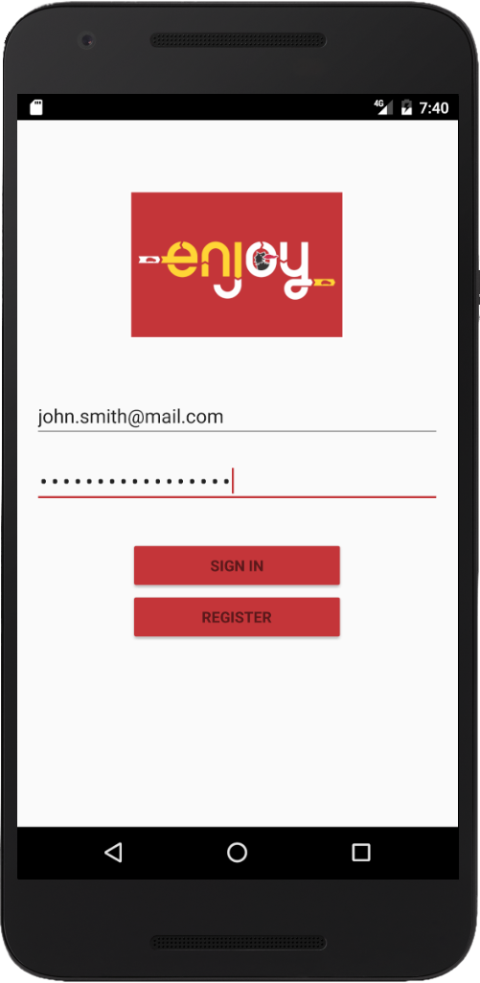
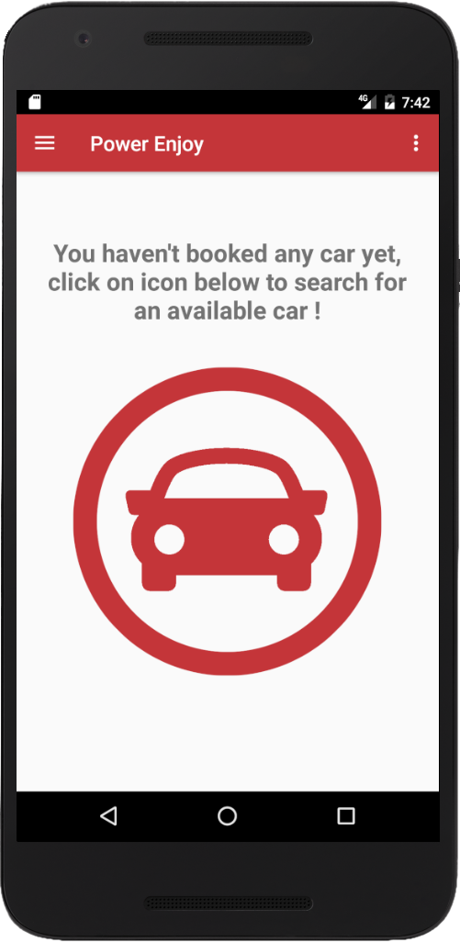
Requirements Analysis

Slide 10
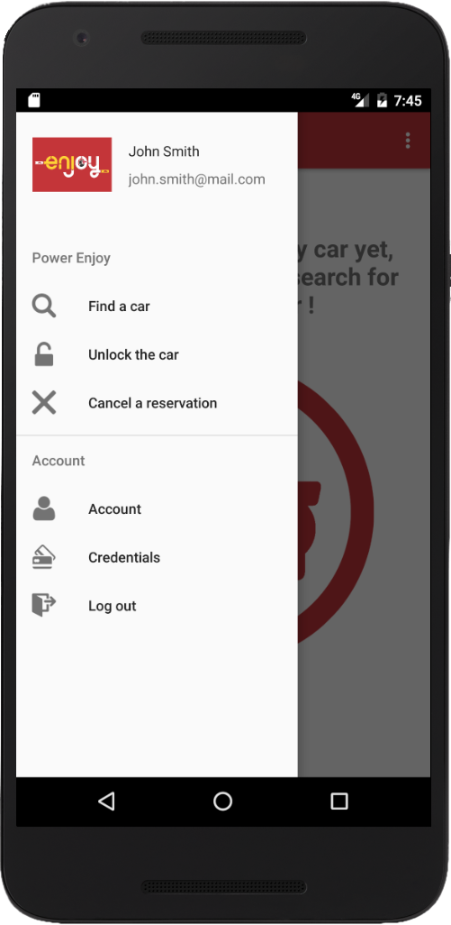
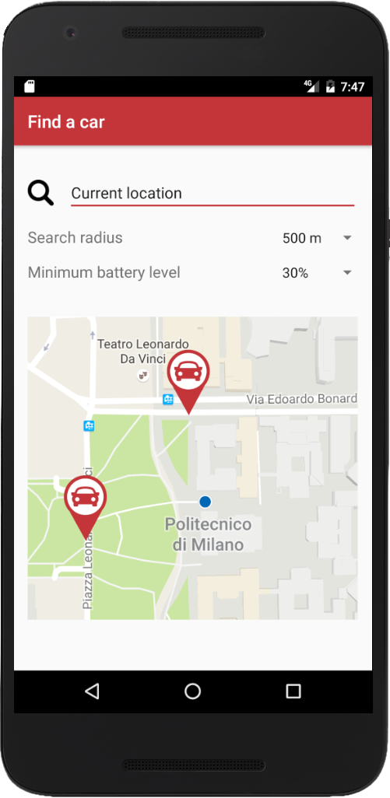
Requirements Analysis

Slide 11
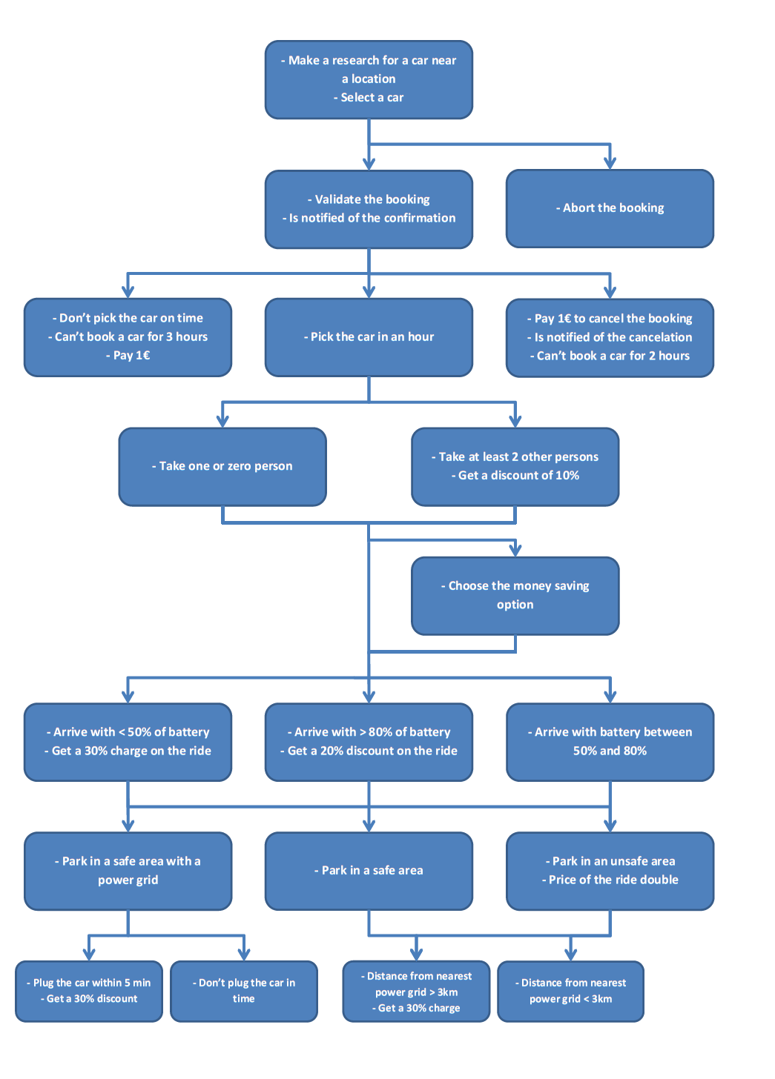
Scenarios

Slide 12
Scenarios

Slide 13
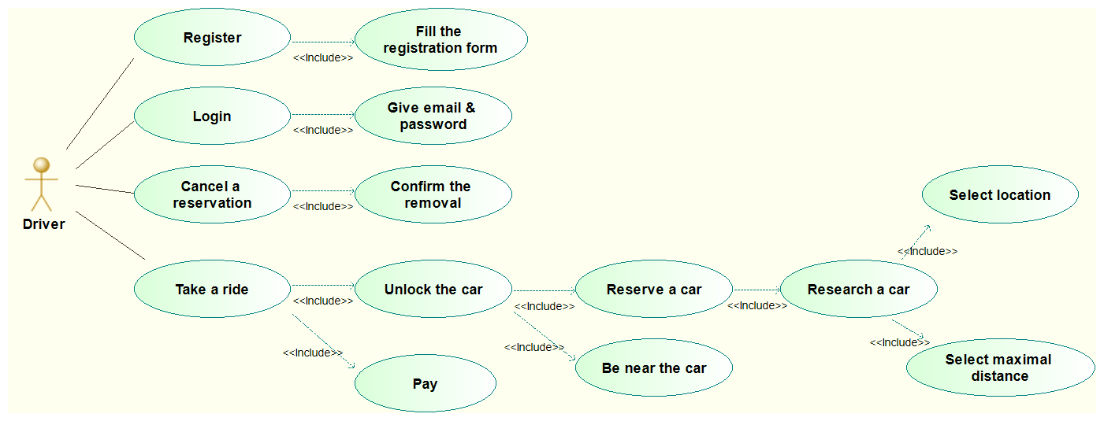
Use Cases

Slide 14
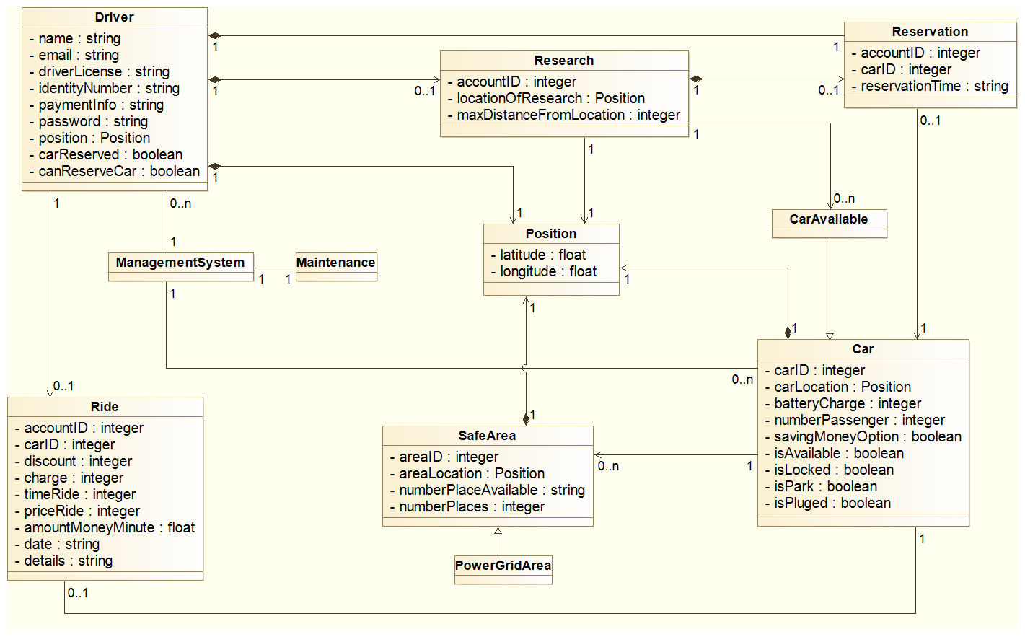
Class Diagram (simplified)

Slide 15
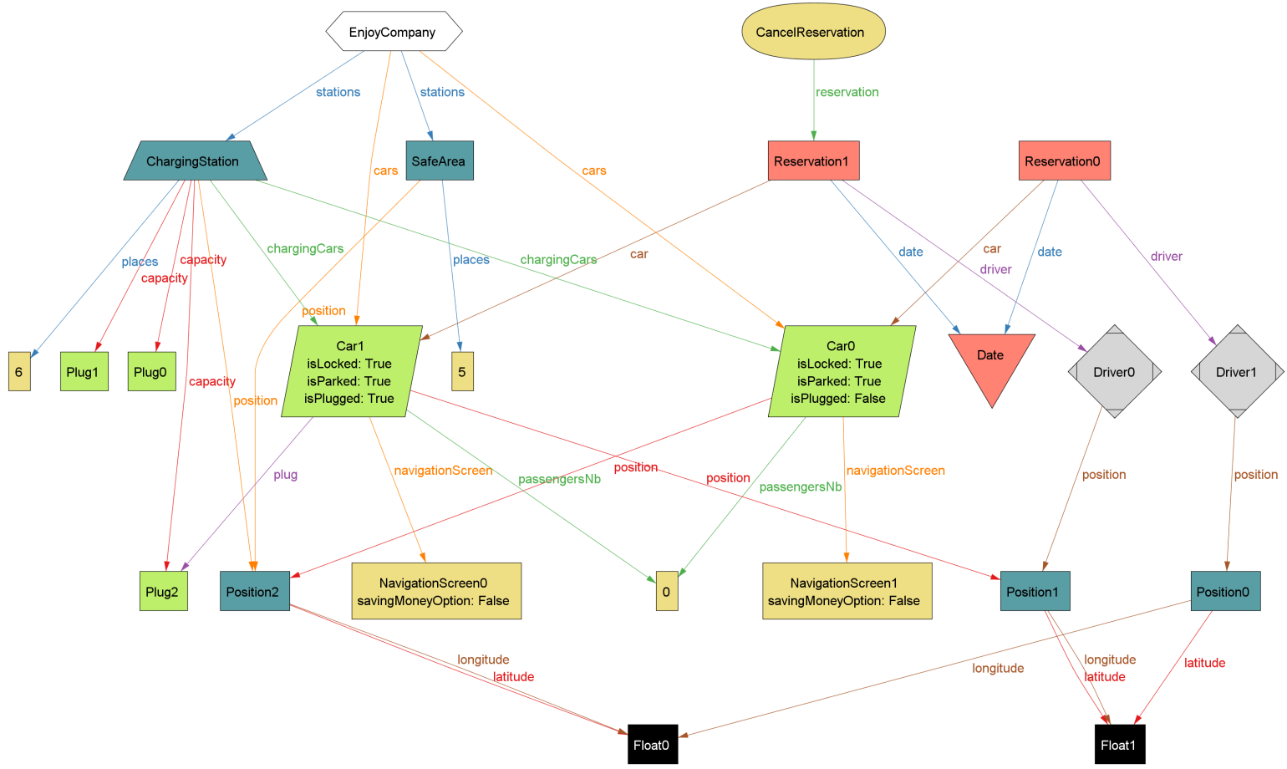
Alloy Model

Slide 16

Thank you

